Slide 1

Enterprise Taxonomies - Context, Structures & Integration
Presentation to American Society of Indexers
Annual Conference – Arlington Virginia – May 15, 2004
Denise A. D. Bedford

Slide 2
Background
Systems analyst & information architect
Cataloger/classifier
Collection development – Russian East European Collections
Acquisitions Librarian/Bibliographic Searcher
Reference librarian
Childrens Librarian
Usability engineer
Worked for publishers & bookstores
Professor -- Information/Library/Computer Science education
I’ve seen it from all angles…

Slide 3
Presentation Overview
Enterprise Content Architecture Basics
Taxonomy Basics
Strategy for creating your enterprise content architecture

Slide 4
Voices of Experience
Recently we looked back at what we had learned in implementing content management systems, intranets, external web sites
As we embark upon an Enterprise Content Architecture we found we had learned 17 lessons
The top lesson that we agreed we had learned was to begin any of these projects with a high level reference model – essentially a blueprint
>5% of my time is devoted to all I will show you today – possible because of reference model base

Slide 5
Enterprise Architecture Basics
Design your Enterprise Architecture to support your goals
Enterprise implies integration and context
High level reference model must take into account the following
  Functional Architecture
  Technical Architecture
  Content Architecture
  Presentation Architecture

Slide 6
What are the Goals of the World Bank Enterprise Architecture?
Facilitate integration and repurposing of content
- Provide broad search and retrieval capabilities
- Increase reuse and decrease redundancy across content providers
Increase the value and quality of content
- Build intelligent relationships among disparate content sources using concepts and metadata
- Define, enforce, monitor processes/procedures on content collections to ensure quality
Simplify and complete the content life-cycle
- Reduce the number of user-facing content entry points by using already existent business processes
- Manage content end-to-end from initial inception to final disposition
Consistent information security and disclosure enforcement
- Bank records must be consistent in order to facilitate disclosure policy compliance and information sharing for partners
Notes:
In addition to the Medium-Term IT Strategy for the Bank, the ISP initiative also gives our content management practice challenges to face. As the ISP move to put in place DMS, WCM and Portal initiatives across the bank the question of VALUE must be answer. With content repurposing we can justify the value of moving banks content into institutional sources. Ones in the central repository, value must be drawn from the content relationships and integration. However, just using and publishing the content is not the only value, value also comes from a simple yet robust management process. Value is also derived from securely disseminating information to all stakeholders on a timely fashion.
How do we accomplish this, What are the success factors which will ensure we will reach theses goals?

Slide 7
Content Integration
Content integration in the World Bank Catalog Search & Browse
Content Integration on the External Web Site
Content Integration in Project Portal
Content Integration in Donors Portal
For example…

Slide 8
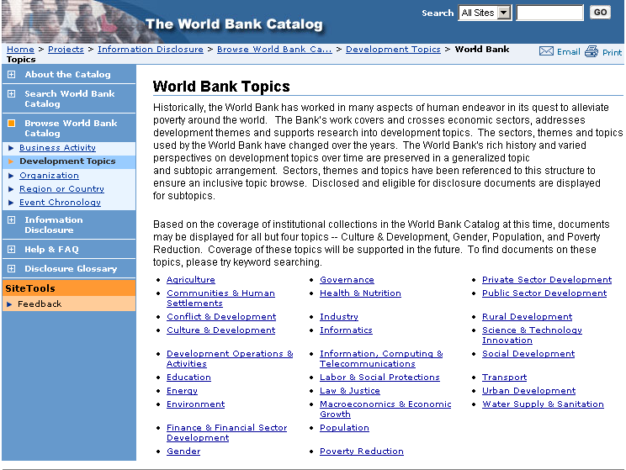
World Bank Catalog Topic Browse

Slide 9
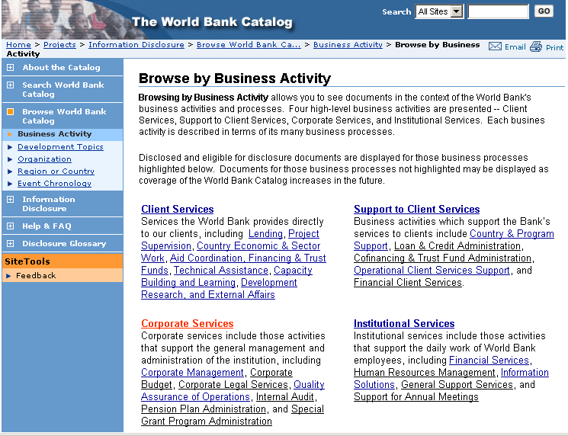
World Bank Catalog Business Activity Browse

Slide 10
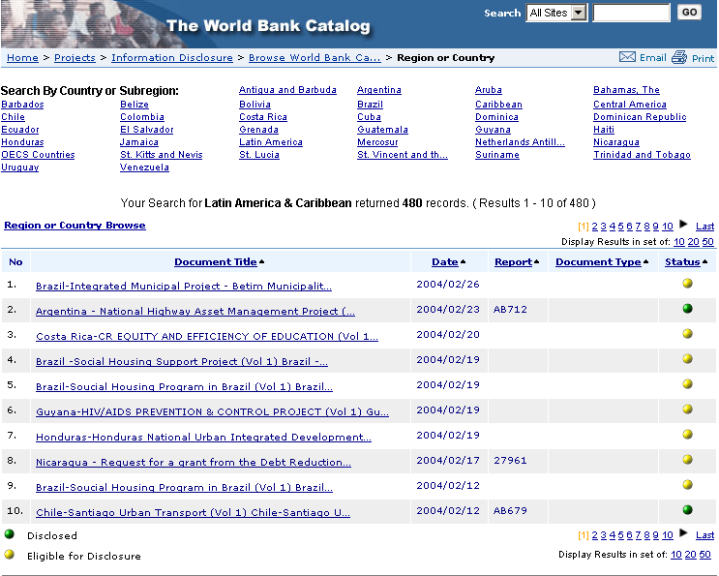
World Bank Catalog Country-Region Browse

Slide 11
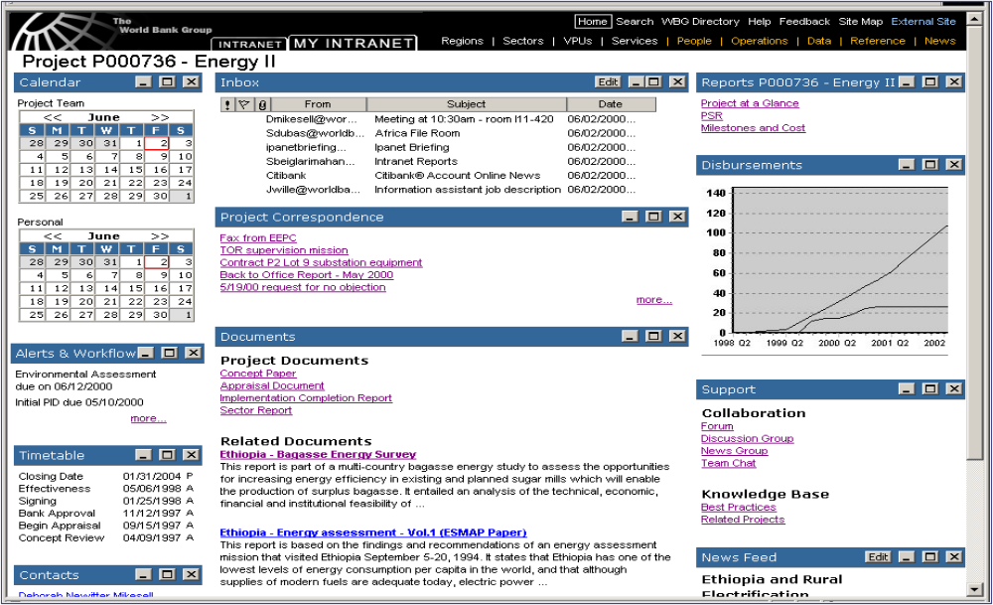






Project Portal – Project Context
Data Charts
Content
Documents &
Records
Content
People &
Communities Content
Publications
Content
Knowledge
Content
People &
Communities
Content
10
Notes:
10

Slide 12

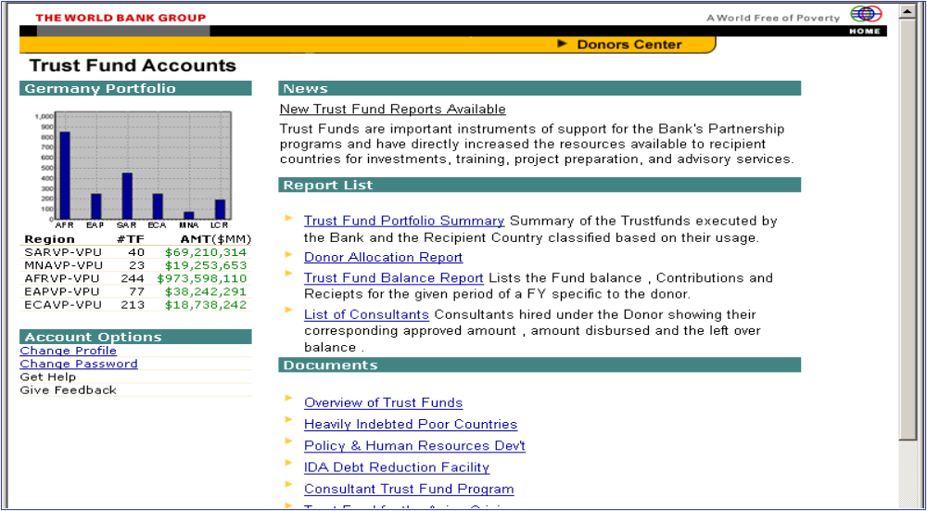



Donor Portal – Donor Context
Data Charts
Data Reports Content
Services Content
Documents & Records Content
11
Notes:
11

Slide 13

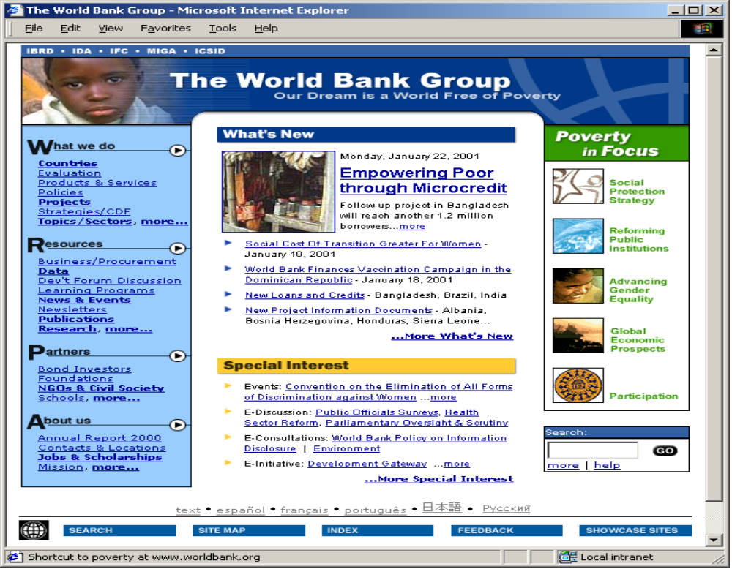






External Web Site – Public Info Context
Communications
Content
Documents &
Records
Content
Knowledge
Content
Services
Content
People &
Communities
Content
Communications
Content
Publications
Content
09 October, 2001
Expanding Access to Content
12
Notes:
12

Slide 14




Audience Focused Context
Retirement Benefits
Voting & Elections
Energy
Legal & Judicial Resources
Tax Resources
Law Enforcement
Passport & Visa
Consumer Protection
Government Locator
Health & Medical
Agriculture

Slide 15
Individual Focused Context
My Voting Information Today
My Retirement Benefits Today
My Heating Bills
My Legal Rights Today In
Regards to a Specific Incident
My Tax Returns
Who are My Law
Enforcement Contacts
Consumer Protection
Pertaining to What I Purchase
My Passport & Visa
My Local Government Offices
My Medical Benefits

Slide 16
Where do you start?
Reference Models

Slide 17
Blueprint Your Enterprise Content Architecture
Blueprint your ECA just as you would a home - by thinking about what it will contain, how it will be used and who will use it,
Would you simply chat with an architect, with a carpenter, a plumber and electrician and trust that they’ll build the home you need?
End game of blueprinting you ECA is a high level reference model
Taxonomies live in every component of your ECA – they become ECA when you integrate them

Slide 18
Benefits of Reference Model
High level reference model enables:
  Open architectures – swapping in and swapping out components over time without loss of investment
  Appropriate functional growth at the component level
  Extensibility of content coverage
  Scalability of the architecture in terms of volume of content and level of use
  Emergence of an enterprise level thinking about how to manage content
  Enterprise level thinking about stewardship and governance of information

Slide 19
Blueprinting Example – World Bank
Let’s walk through a blueprinting exercise to see how we came to discover our functional. technical, content and presentation architectures

Slide 20
Content Scatter & Integration
Content Integration problem --
  Documents in IRIS, ImageBank, IRAMS…
  Data in BW, DEC SIMA queries in central, regional & agency databases, CDF indicators, GDF data reports, .
  Publications in JOLIS, Office of Publisher, Thematic Group databases…
  Communications in External Affairs, Office of President, DEC, IRIS…
  People & Communities in YourNet, PeopleSoft, WBDirectory,…
  Knowledge in Notes databases, Oral History program,…
  Services in WB Yellow Pages, Service Portal,…
  Collections in EIU database, Oxford Analytica
Notes:
7

Slide 21
Kind of Content to Support
Content type is different than format type – content is defined as the kind of information that is contained in an information object
Began with a comprehensive survey of all kinds of content in our information systems including SAP, Lotus Notes Databases and Email, Document Management, Archives, Intranet, External Web, unit-specific repositories, EnCorr correspondence system
Grouped content we found into eight top level classes – retained the second level classes as system specific – we are harmonizing at second level over time
Top level classes were defined by the purpose of the content as well as content architecture/structure

Slide 22
Enterprise Level Content Type Classification Scheme
Begin to use the architecture of content to manage from the point of creation through full life-cycle
Top Tier (Institutional) Content Types
  Comprised of broad ‘buckets’ or content types
  Comparable metadata & meta-information
  Accessed, used & presented in similar ways
  Content lives in different source systems
  Virtual attribute for metadata at institutional level
  Facilitates searching for a type of content across sources
Second Tier (Business System) Content Types
  Source system resource types mapped to top tier groups
  Specific administrative value in source system
  Access controlled at this level
  Content typically lives in one source system
6
Notes:
6

Slide 23
Enterprise Content Architecture
Each organization has to make their own decisions here
We have to respect the business system ownership of the content
We leave business system information in tact, map to enterprise content architecture
ECM then means managing functionality using a high level set of metadata across the organization
Means harmonizing attributes and in some cases managing the values for those attributes

Slide 24

Big Picture Enterprise Content Architecture
Site Specific
Searching
Publications
Catalog
World Bank Catalog/
Enterprise Search
Recommender
Engines
Personal
Profiles
Portal Content
Syndication
Browse &
Navigation
Structures
Metadata Repository
Of Bank Standard Metadata
Reference Tables
Topics, Countries
Document Types
Transformation
Rules
Data
Governance
Bodies
Metadata
Extract
Metadata
Extract
Metadata
Extract
Metadata
Extract
Metadata
Extract
Metadata
Extract
IRIS
Doc Mgmt
System
Board
Documents
Metadata
Web
Content
Mgmt.
Metadata
IRAMS
Metadata
JOLIS
Metadata
InfoShop
Metadata
Concept Extraction, Categorization & Summarization Technologies

Slide 25
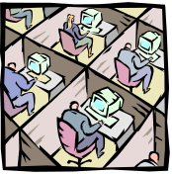

World Bank ECA
Content
Contributor
End User
DELIVERY
Content Systems
Metadata Management and Security Services
ePublish
PDS
….
access
rules
Content Access Services
Content Management Services
view
multilingual srch
workflow
create/del.
check in/out
retention
schedule
search
syndication
versioning
declare
classification
browsing
notification
Business
Activity
Topic Class Scheme
Content Integration and Archives Services
thesaurus
relate
Connector
Concept extraction
rules evaluator
harmonize
Adapter
Series Names
monitors
Archives
Store
Over
Time
Documents,
Images, Audio,
Data records
Metadata
warehouse
SAP
(R/3, BW)
Notes /
Domino
logs
People
Soft
iLAP
Repositories Services
Business Systems

Slide 26
Basic Functional Components for Goals
Content Integration Services
  Metadata harvest, rationalization and harmonization
  Access to metadata entries, content maps and content
Repository Services
  Defined storage strategy for content over time
  High performance, accessible and scalable metadata and content stores
Content Access Services
  Bank-wide search and retrieval
  Access control for all bank records
  Syndication of content to partners institutions – e.g. GDG

Slide 27
Basic Functional Components for Goals
Content Management Services
  Content management function oriented services – versioning, check-in/check-out, collaboration, work flow
Metadata Management and Security services
  Services managing reference data, data dictionaries, taxonomies, thesaurus, business rules (access, security, disposition) which cut across all services

Slide 28
Enterprise Thinking
In the future, we hope to achieve enterprise wide use of full range of reference tables
Some will be ‘closed loop’ stewardship models
Some will be ‘bi-directional’ stewardship models
Idea is that different groups thoughout the enterprise will become stewards of different reference sources
Governance models and taxonomy structures need to be suited to their purpose – not just one kind of taxonomy or one way to govern

Slide 29
Content Architectures
Content types can evolve into content architecture specifications
Content architecture specifications can evolve into input templates – in future building from content element level
You cannot repurpose and decompose working from BLOBs
To manage content type creep, define libraries of content elements within the Top Level types
Grow content templates at the element level but within content type element libraries
Example of doing top down and bottom up development work

Slide 30
Designing for Use
Metadata provides the lowest level of the blueprint for how our content will be used
In an ECA, assumption is that use is enabled across systems
Need to have a core set of metadata that are available across systems to support the ECA
If you have enterprise content types then you are in a better position to see what that core set is
Traditionally, metadata focuses heavily on content features and pays less attention to how it will be used

Slide 31
World Bank Metadata Requirements
Standard metadata schemes are primarily encoding schemes – don’t just accept someone else’s encoding scheme
You should begin by understanding purpose of metadata attributes in a schema
We have used Use Case modeling as a technique to:
  help us understand how content will be used
  kinds of access points we need
  how each access point will behave
  what kind of an underlying taxonomy supports it
Knowledge & Learning Environment

Slide 32
Metadata Basics
Assume you will not change the current business systems
Challenge here is to manage complexity, maintain source systems, respect content security & still meet users expectations
Support integrated use by creating a warehouse of metadata pertinent to access, search, syndication, use management, records compliance and learning
Define metadata attribute super classes to which existing business system metadata are mapped
Attributes may be rationalized, harmonized or value-controlled within super classes
Notes:
13

Slide 33
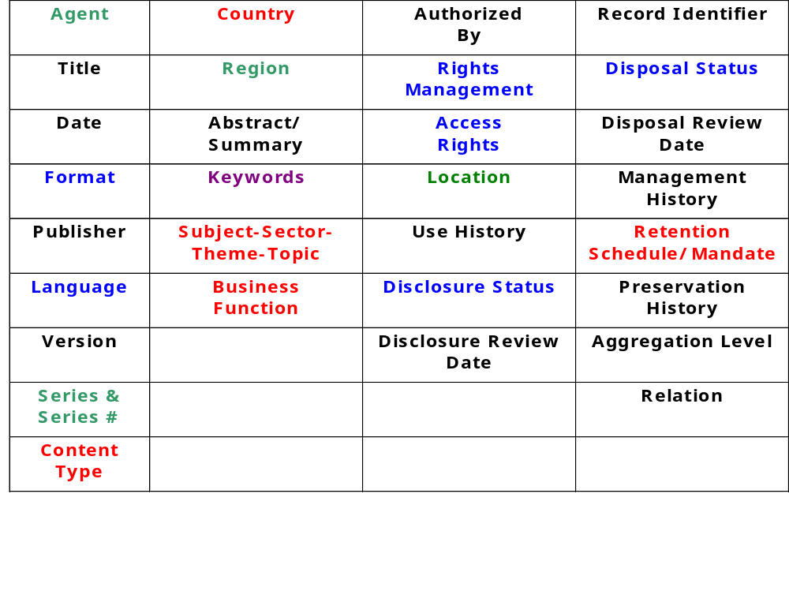
Bank Metadata – Purpose & Taxonomies
Identification/
Distinction
Search &
Browse
Use Management
Compliant Document
Management
Flat Taxonony
Hierarchical
Taxonony
Network
Taxonomy
Faceted
Taxonomy

Slide 34
Taxonomy Examples
Enterprise Topic Classification Scheme – hierarchical taxonomy
World Bank Thesaurus – English, French, Spanish – network taxonomy
Metadata Attribute Detailed Specifications – faceted taxonomy
Content Type Classification Scheme – hierarchical taxonomy
Transformation Rules – faceted taxonomy

Slide 35
The ECA Taxonomy
View
Thesaurus
Language
Topics

Slide 36
Taxonomy Basics
Given this blueprint, let’s step back and examine:
  Where we find taxonomies
  What kind of taxonomies we need
  Where we have what we need already
  Where we should integrate what exists
  Where we need to start from scratch
  When we do start from scratch, how do we begin

Slide 37
Definition of a taxonomy
“System for naming and organizing things into groups that share similar characteristics”
Taxonomy
Architectures
Applications
Notes:
Review of Basic Concepts & Approaches
Essential concepts include:
content
metadata & metadata repositories
navigation architectures
search architectures
portal architectures
Information architectures in portals and web environments are increasingly complex, integrating technologies to deliver value to users. Seamless integration is the goal. Taxonomies are critical data structures that help us to build a sustainable foundation, to integrate efficiently and to manage the complexity. Whole information architecture is more adaptable and sustainable over time if it adheres to established standards and best practices. Whole Information Architecture is more cost effective if new technologies currently being researched or under development can be integrated without re-engineering the base. Like the content and processes they support, each component of a portal has a life cycle.

Slide 38
Taxonomy Architectures
Taxonomy architectures are important to designing taxonomies which:
  are suited to their purpose
  sustainable over time
  provide strong application support to information applications in the new challenging web environment
Taxonomy = architecture + application + usability
Time is too short today to go into the usability issues deeply, but be aware that they are design & implementation issues

Slide 39
Taxonomy Applications
Taxonomies are structures which can be explicitly presented - they can be distinct data structures or interface features
Taxonomies are structures which can be implicitly designed into an application - structures which are embedded or designed into the content or transaction that is being managed

Slide 40
Taxonomy Architectures
There are four types of taxonomy architectures:
  Flat
  Hierarchical
  Network
  Faceted
In my experience, most of the problems we encounter working with ‘taxonomies’ derive from to the fact that we don’t establish the type of taxonomy architecture we need before we begin creating them!

Slide 41
Flat Taxonomy Architecture
Energy Environment Education Economics Transport Trade Labor Agriculture

Slide 42
Flat Taxonomies
Group content into a controlled set of categories
There is no inherent relationship among the categories - they are co-equal groups with labels
The structure is one of ‘membership’ in the taxonomy
  Alphabetical listing of people is a flat taxonomy
  Lists of countries or states
  Lists of currencies
  Controlled vocabularies
  List of security classification values

Slide 43
Facet Taxonomy Architecture
Faceted taxonomy architecture looks like a star. Each node in the star structure is associated with the object in the center.

Slide 44
Facet Taxonomies
Facets can describe a property or value
Facets can represent different views or aspects of a single topic
The contents of each attribute may have other kinds of taxonomies associated with them
Facets are attributes - their values are called facet values
Meaning in the structure derives from the association of the categories to the object or primary topic
Put a person in the center of a facet taxonomy for e-gov, for KLE initiatives

Slide 45

Metadata as Facet Taxonomy
Metadata is one type of faceted taxonomy
Each attribute is a facet of a content object
  Creator/Author
  Title
  Language
  Publication Date
  Access Rights
  Format
  Edition
  Keywords
  Topics

Slide 46
Hierarchical Taxonomy Architecture
A hierarchical taxonomy is
represented as a tree architecture. The tree consists of nodes and links. The relationships become ‘associations’ with meaning. Meanings in a hierarchy are fairly limited in scope – group membership,
Type, instance. In a hierarchical taxonomy, a node can have only one parent.

Slide 47
Hierarchical Taxonomies
Hierarchical taxonomies structure content into at least two levels
Hierarchies are bi-directional
Each direction has meaning
Moving up the hierarchy means expanding the category or concept
Moving down the hierarchy means refining the category or the concept

Slide 48
Network Taxonomy Architecture
A network taxonomy is a plex architecture. Each node can have more than one parent. Any item in a plex structure can be linked to any other item. In plex structures, links can be meaningful & different.

Slide 49
Network taxonomies
Taxonomy which organizes content into both hierarchical & associative categories
Combination of a hierarchy & star architectures
Any two nodes in a network taxonomy may be linked
Categories or concepts are linked to one another based on the nature of their associations
Links may have more complex meaningful than we find in hierarchical taxonomies

Slide 50

Network taxonomies
Network taxonomies allow us to design complex thesauri, ontologies, concept maps, topic maps, knowledge maps, knowledge representations
The future semantic web will have a network architecture where the associations among the concepts not only have distinct meanings but also have contextualized rules to link them
Often meaningful links take form of a ‘prolog-like’ grammar
  has_color
  is_a_cause_of
  is_a_process_of
Caution – don’t let someone build a hierarchy for you when you need a network structure

Slide 51
Taxonomy Integration & Harmonization
Flat
  Compare across all entities, attempt to harmonize & integrate, consider another structure if you cannot integrate effectively
Hierarchy
  Begin in the middle, then move up & down iteratively
Faceted
  Work facet by facet
Networked
  Discard relationships, focus on harmonizing concepts first, then re-establish relationships

Slide 52
Who Will Use ECA?
Flexible presentation architecture is CRITICAL
Inside -- Bank Staff
  Multilingual, multicultural staff, 29 areas of expertise – most staff are high level experts, highly educated international staff, X,xxx located at Headquarters in DC, X,xxx located in country offices around world, some high end and some low end connectivity, most all technology enabled
Outside -- General Public, NGOs, Governments ….
  Multilingual, multicultural, expert to novice levels, wide range of education levels, wide range of connectivity options, wide range of levels of expertise in all areas
Restricted architecture ‘designed by GUI’ is destined to fail

Slide 53
Implications of Use for Blueprinting
Multilingual content search, presentation & creation
Multiple topics presented from different perspectives in different views, but centrally integrated to address recall issues
Deep indexing for experts mapped to high level indexing for novices with steps guiding up and down
Content contribution & access by location
Integrated content contribution & access at enterprise level
Content delivery directly from ECA as well as hard copy from central & decentralized sources

Slide 54
Programmatic capture of metadata
Challenge to meet the scalability required using only human capture approach for tens & hundreds of thousands of content objects
Quality of metadata impacts quality of access – when we ask untrained catalogers to capture metadata quality suffers
Quantity of metadata needs to increase in order to support better access – three keywords not sufficient to support granular access, now we need to have 12 to 30 to describe an object
We’re beginning to see that consistency of metadata is better achieved programmatically with catalogers putting their expertise into high quality, full elaborated reference sources

Slide 55
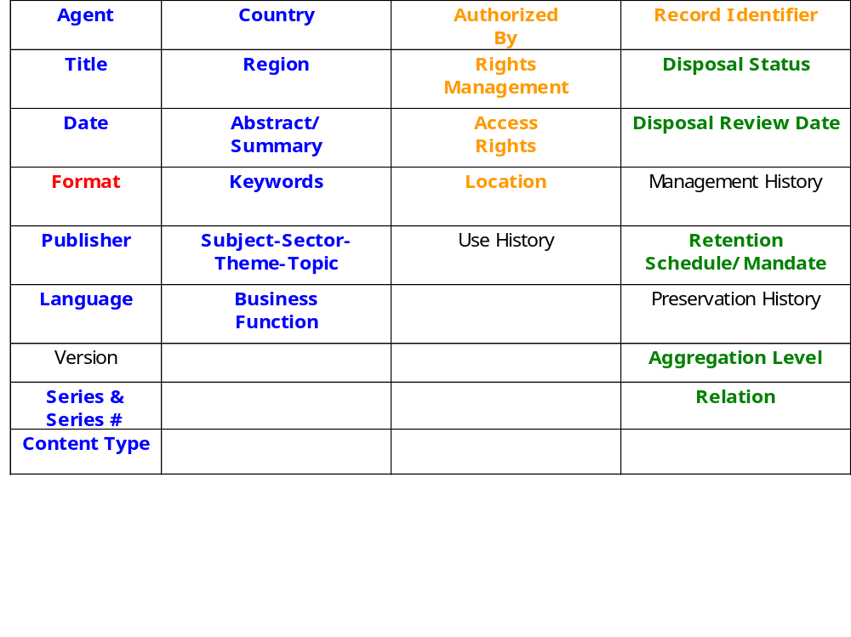
Metadata Capture Methods
Bank Standard Metadata
Identification/
Distinction
Search &
Browse
Use Management
Compliant Document
Management
Programmatic Capture
Extrapolate from Business Rules
Human Capture
Inherit from Structured Content
Inherit from System Context

Slide 56



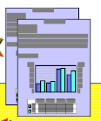

The Vision
Metadata Warehouse
Content Creation
Content Capture
& Programmatic
Extraction
Content Processed
Without Review
Selective Metadata
Attributes
Content Processed
& Reviewed By
Human
Content Creation
Concept Validation
Against CDS & Thesaurus
Concept Extration, Summarization
& Categorization Engine

Slide 57
What are we looking for?
Persistent metadata
  tools process single objects once
  invest once, use multiple times
  low risk because it feeds into a modular search architecture
  can introduce new smarter components as technology advances
  supports repurposing, republishing, syndication of content in a portal environment
  Not a single, hard coded structure
Metadata in multiple languages to support multilingual access & information management

Slide 58
In conclusion
I apologize if this presentation seems to be a little bit of everything
The problem is that taxonomies are critical components of any and all information systems, whether it is an integrated library system, a portal or a content management system
I hope there has been some value for you in this presentation – please feel free to use or repurpose any part of it that makes your work easier!

